Slide 1
The Android App Market on Google Play
By:
Name: Saher Safwat
ID: 34-14269

Slide 2
Questions:
Basic Analysis Questions:
What are the categories and their count?
How many Apps have full rating?
What are the most famous Apps based on Reviews?
What is the most common Android Version used?

Slide 3
Questions:
Further Analysis Questions:
How does the ratings differ in general?
How are the differences distributed across different app categories?
Are there any categories where the differences are statistically significant?

Slide 4
Preparing Data
Changing some data types to float
Check duplicates
Check and clean type values
Check and drop NaN values

Slide 5
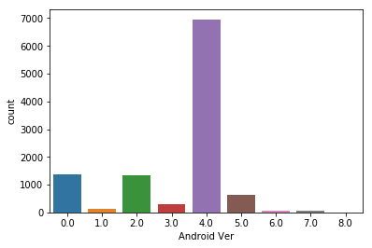
Visualizations:
The most used visualizations are histograms. Why?
Lets you discover, and show, the underlying frequency distribution (shape) of a set of continuous data. This allows the inspection of the data for its underlying distribution (e.g., normal distribution), outliers, skewness, etc.
Most Android Version used by users:

Slide 6
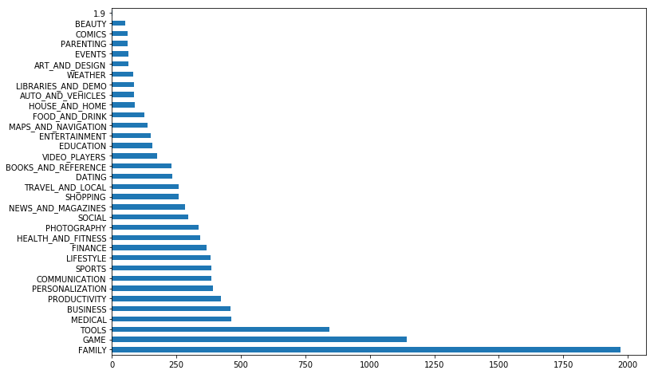
Visualizations:
Categories & Count:

Slide 7
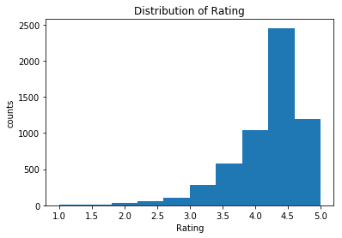
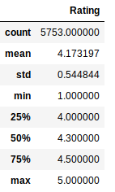
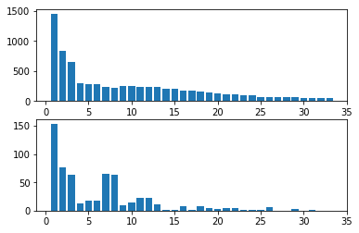
Visualizations:
Distribution of Rating:
Distribution of paid and
Free apps across different
Categories:

Slide 8
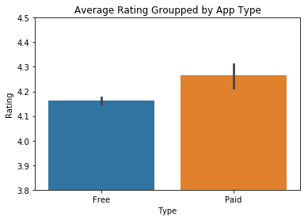
Visualizations:
Average Rating between Paid
And free Apps:
In general, Free apps, with an average rating of 4.16, are lower rated than Paid apps with an average rating of 4.27. And the average rating for all apps is 4.17, so Free apps are rated below average, while Paid apps are rated reletively higher than the average score.

Slide 9
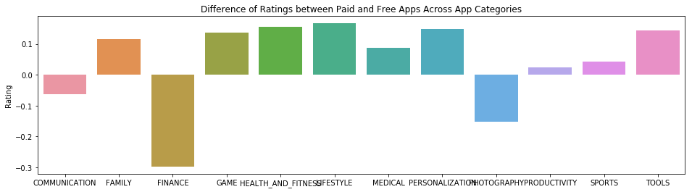
Visualizations:
Difference of Ratings between
Paid and Free Apps:
While paid apps are generally higher-rated than free apps, and so in most app categories, there are still some app categories where free apps are more likely to be favored than paid apps. For example, there are three categories of COMMUNICATION, FINANCE and PHOTOGRAPHY. The total number of free apps in the FINANCE group is almost 0.3 higher than the paid apps, which is also the highest.

Slide 10


